Slide 1
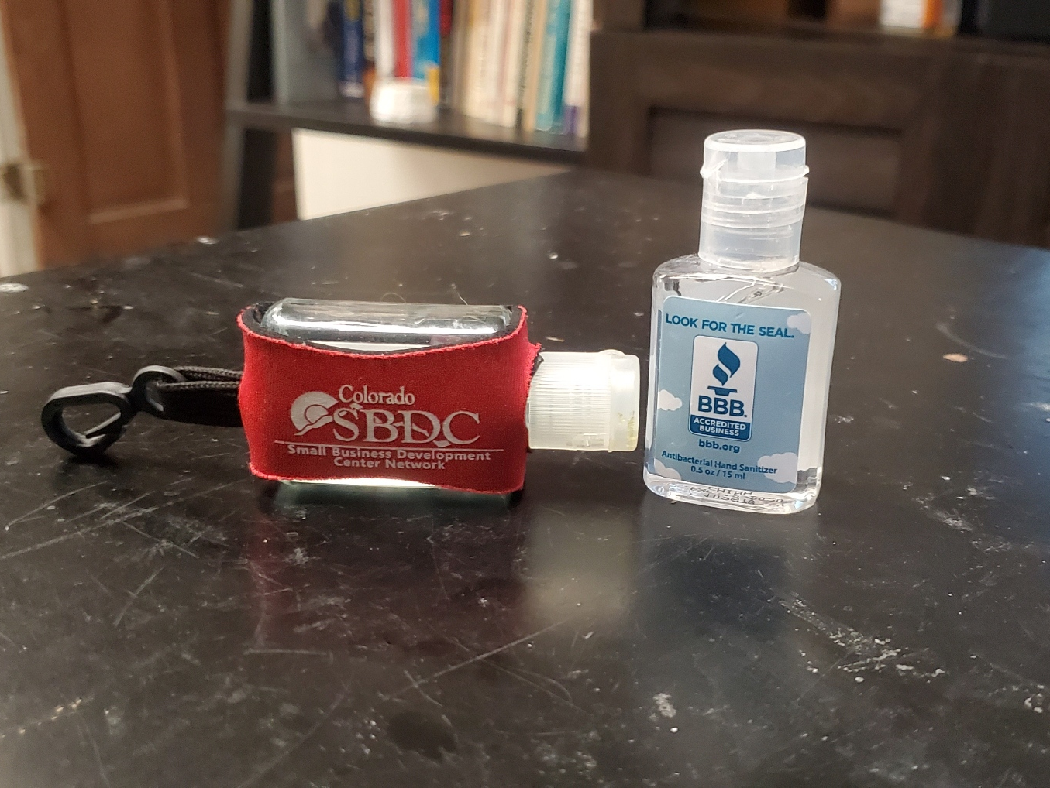
GET YOUR HAND SANITIZER FROM A SOURCE THAT YOU TRUST

Slide 2
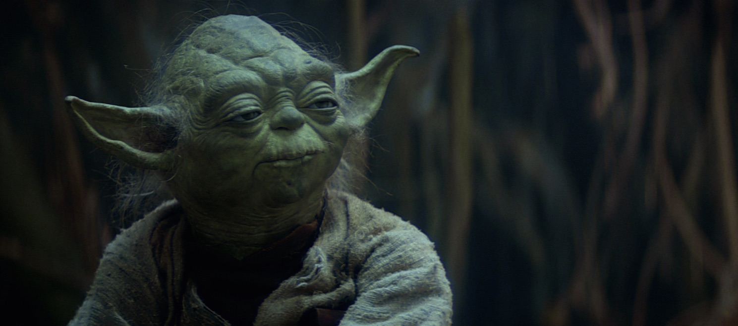


“Luminous beings are we, not this crude matter” -Yoda
May the 4th be with you!

Slide 3
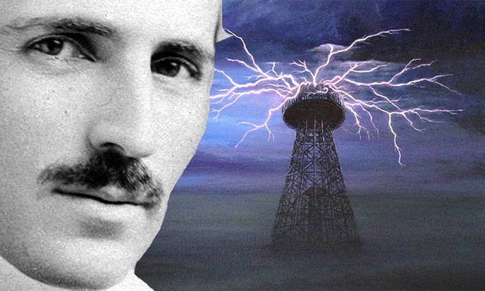
-Nikola Tesla
“If hate could be turned into electricity, it would light up the world.
Peace can only come as a natural consequence of universal enlightenment and merging of races, we ae still far from this blissful realization.”

Slide 4
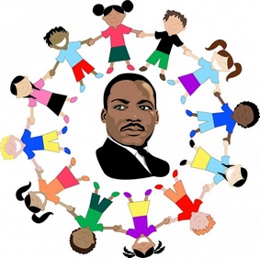


“Darkness cannot drive out darkness; Only LIGHT can do that. Hate cannot drive out hate; Only LOVE can do that.”
Martin Luther King, Jr.
This Photo by Unknown Author is licensed under CC BY-SA-NC

Slide 5
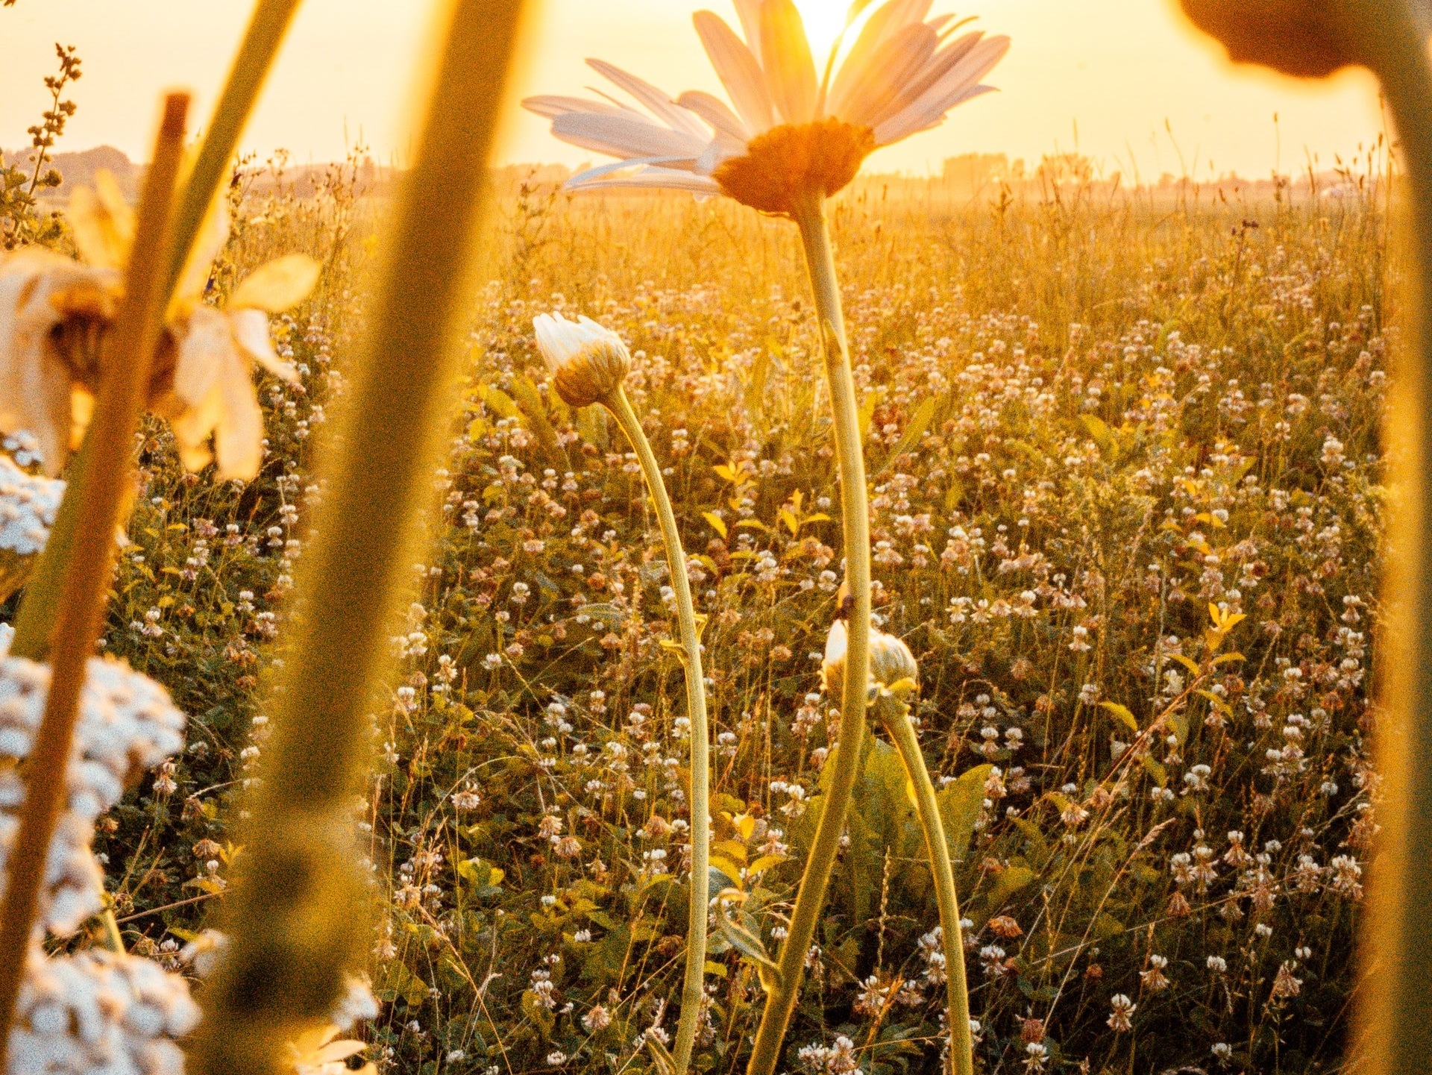

I believe God is in me as the sun is in the color and fragrances of the flower- the light in my darkness, the voice in my silence.
-Hellen Keller

Slide 6
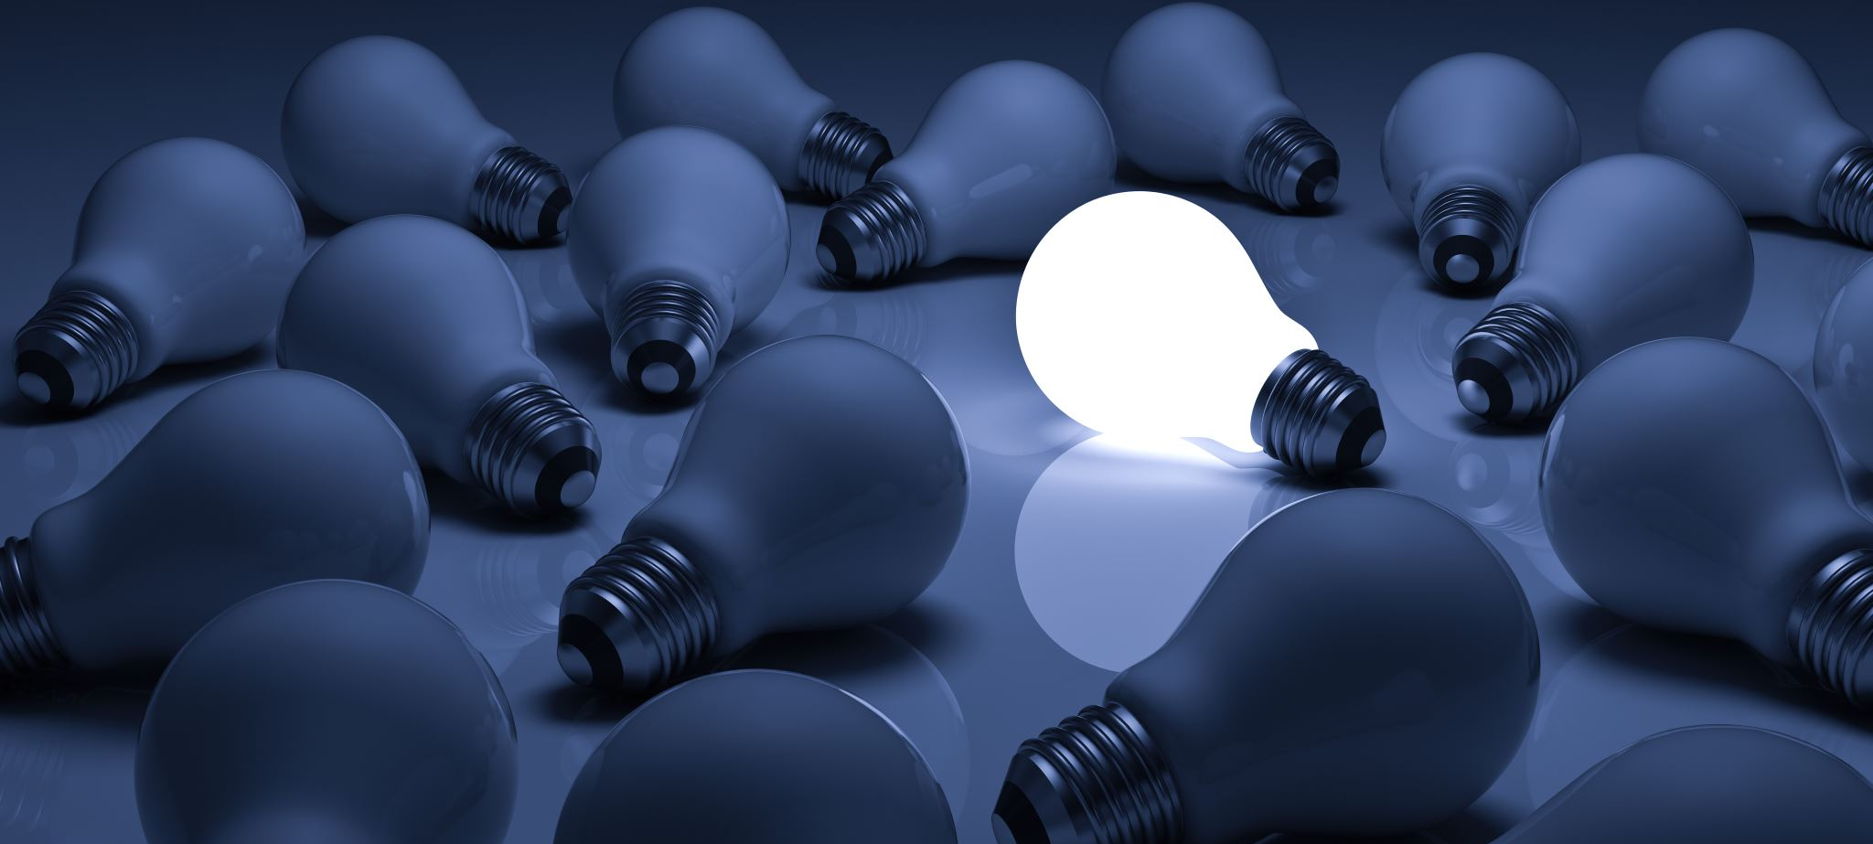

Whenever you see darkness, there is an extraordinary opportunity for the light to burn brighter
Bono

Slide 7

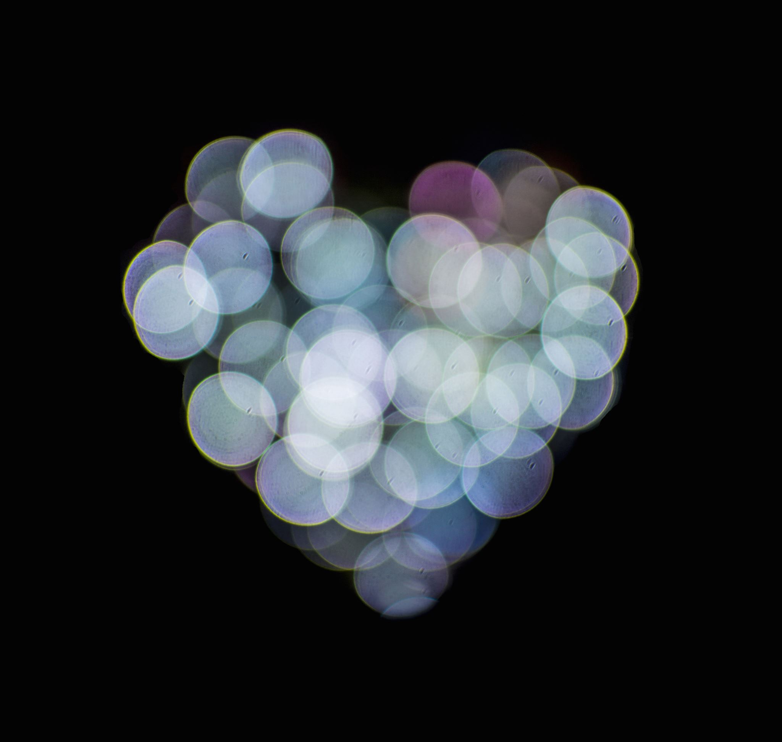




Love is heavy and light, bright and dark, hot and cold, sick and healthy, asleep and awake- it is everything except what it is! -William Shakespeare

Slide 8

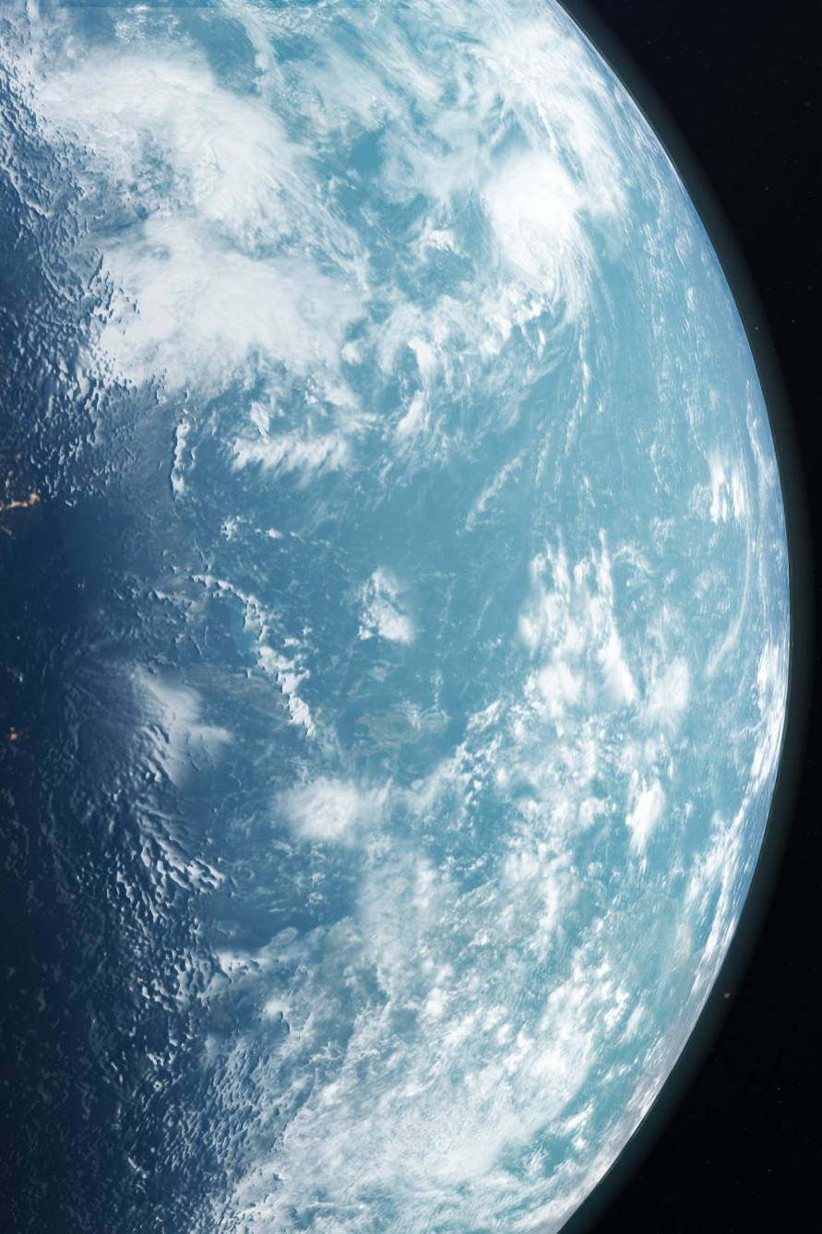


Every day you dare to dream, you fight back the darkness and add a little more light to the world.
Holley Gerth

Slide 9
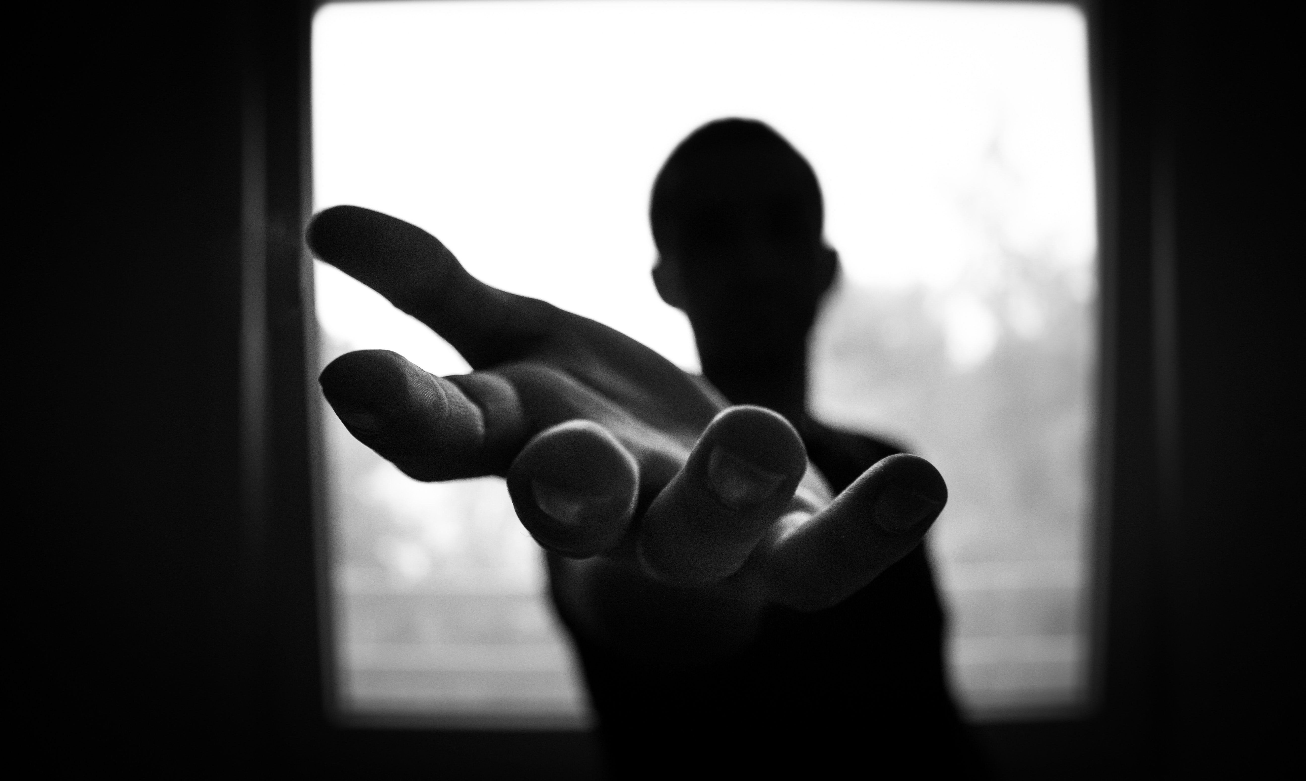


A good friend finds you in the dark and carries you back to the light.
Darlene Schacht

Slide 10
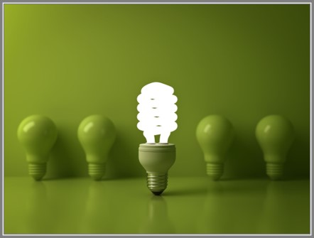
-Nicole spiritualwisdommagazine.com
Never let anyone's darkness and negativity dim the brightness of your own soul.
Play in the light
Breath in the
light
Be the light

Slide 11
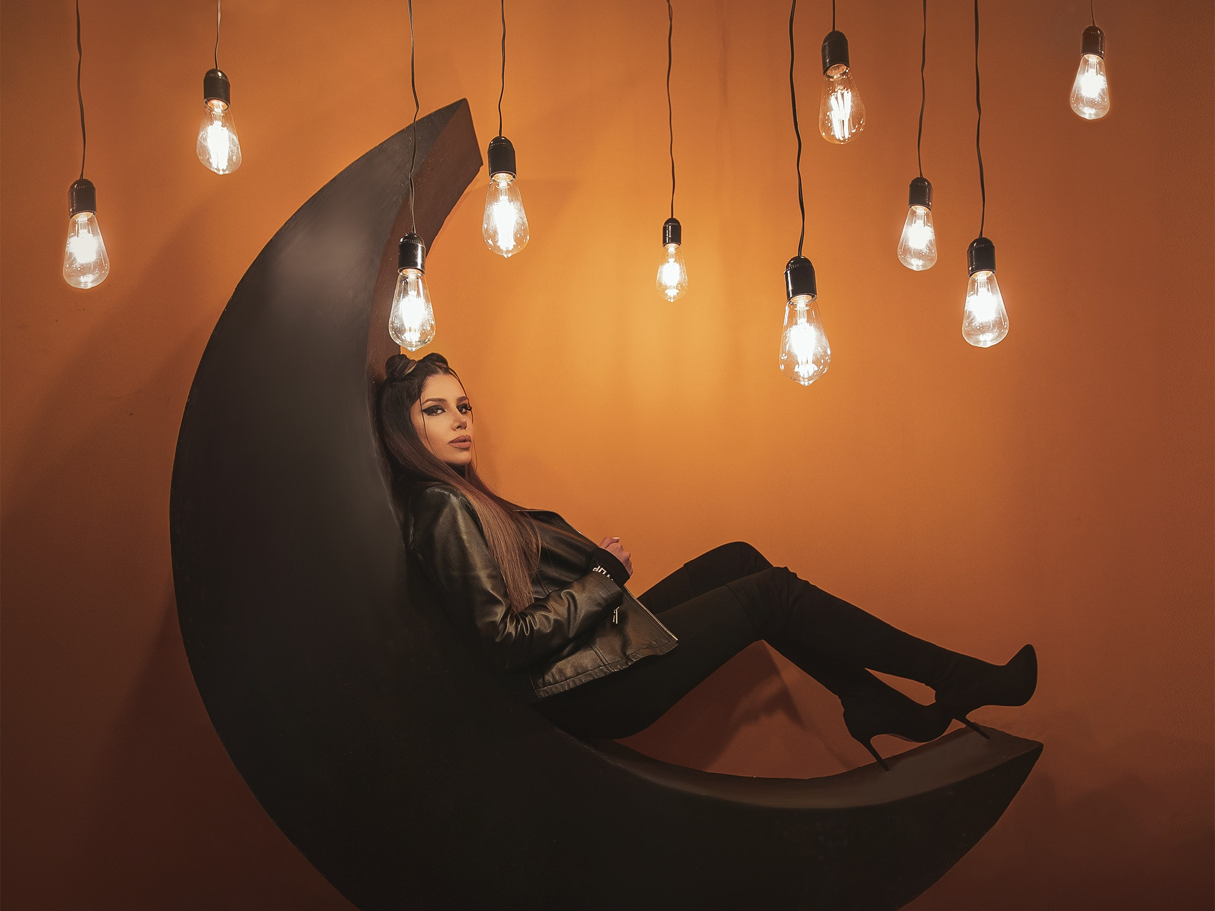
When the night has come And the land is dark And the moon is the only light we’ll see, I won’t be afraid, Just as long as You stand by me
-Ben E. King

Slide 12
Faith means living with uncertainty- feeling your way through life, letting your heart guide you like a lantern in the dark
When you think Light, think Lytle
Betterlifethoughts.com

Slide 13
Tyler Knott Gregson
We are the silver lining in any and every dark cloud we could ever find. There is no need to go looking for the light when you bring it with you.

Slide 14
Michael D’Aulerio
It was in the darkness where I found the light. When I let go of my pride, my humility grew. It took enormous suffering to align with an infinite joy.

Slide 15
St Catherine of Sienna
Start being brave about everything, driving out darkness and spreading light as well

Slide 16
TKW
The world has seen our darkness
Now
Let’s show it out light

Slide 17
Elder Hales
Don’t confuse light with darkness, and darkness with light.

Slide 18
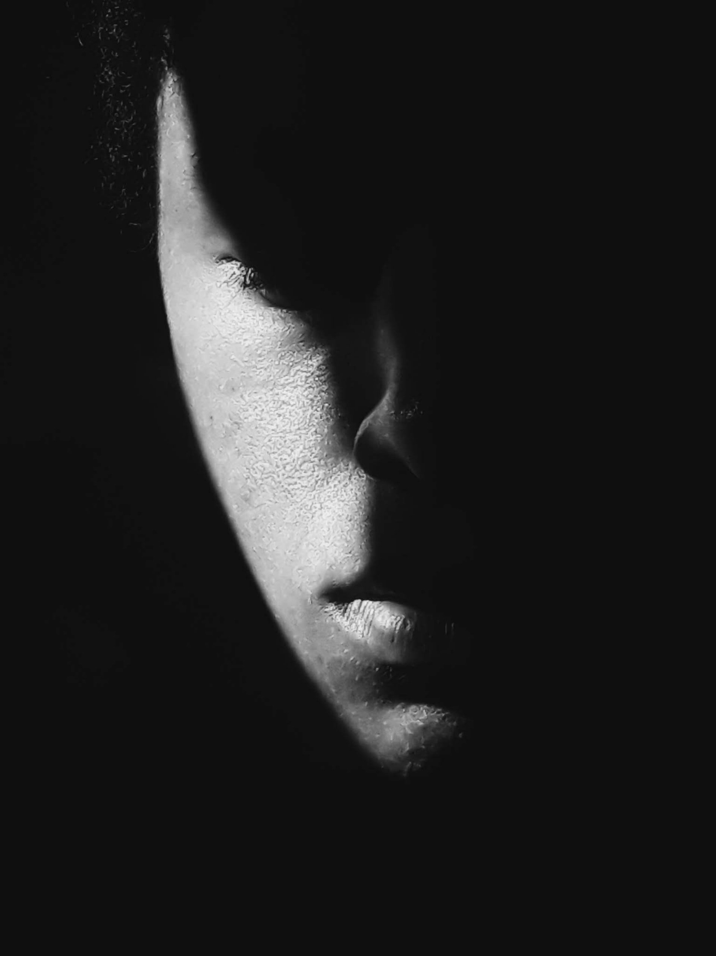
We’ve all got both Light and Dark inside of us. What matters is the part we choose to act on, that’s who we really are.
Sirius Black
J.K. Rowling

Slide 19
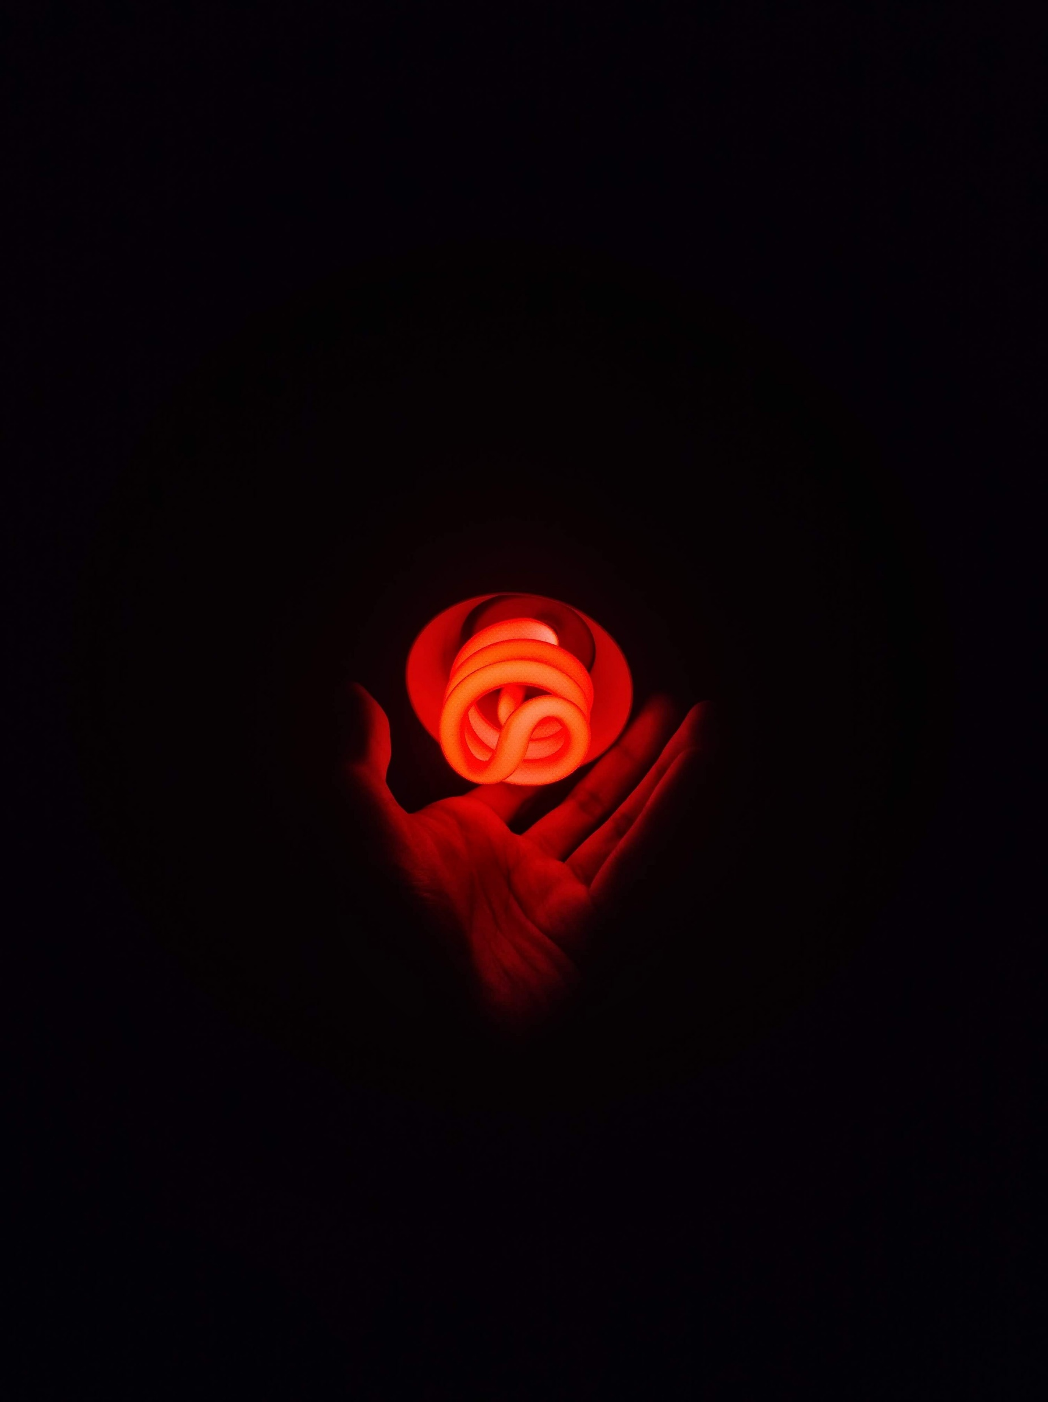
I wish I could show you when you are lonely or in darkness the astonishing light of your own being.
Persia

Slide 20
The darkness. It’s still there. Maybe it’ll never really fully go away. Maybe it’s there to remind us to look at the light that surrounds us.
Wonder Park

Slide 21
Happiness can be found in the darkest of times if only one remembers to turn on the light

